Slide 1
White Biotechnology (Industrial Biotechnology)

Slide 2
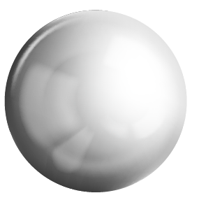

White Biotechnology
Industrial or White Biotechnology uses microorganisms and
enzymes to produce goods for industry, including chemicals, plastics, food, agricultural
and pharmaceutical products, and energy carriers.

Slide 3
White Biotechnology
Renewable raw materials and an
increasing waste from agriculture and forestry are used for the manufacture of industrial goods. Countless metabolic processes take place in a single cell. These processes break down and convert nutrients that have been taken up into new products.

Slide 4
White Biotechnology
Enzymes are
involved in controlling and coordinating reactions that happen simultaneously or
consecutively. Humans have been making use of microbial and enzymatic processes for a
long time.

Slide 5
White Biotechnology
Microorganisms and enzymes can
be used for the production of food supplements such as vitamin B2, biobased plastics such as polylactic acid, and energy carriers such as biogas and bioethanol (Dossier Dec.09, 2013 BIOPRO Baden-Württemberg GmbH).

Slide 6
Biotechnology in Environment
It is the application of processes for the protection and restoration of the quality of the environment, it can be used to detect, prevent and remediate the emission of pollutants into the environment in a number of ways.

Slide 7
Biotechnology in Environment
Solid, liquid, and gaseous wastes can be modified, either by recycling to make new products or by purifying so that the end product is less harmful to the environment. Replacing chemical materials and processes with biological technologies can reduce environmental damage (Kallyani Godani).

Slide 8
According to an Aftermath specialist in Trauma Cleaning and Biohazard Removal Environmental, pollutants continue to be a major global concern. However, thanks to the evolution of bioremediation technology, we are able to diminish some of the damaging effects that these pollutants have had on our environment.

Slide 9
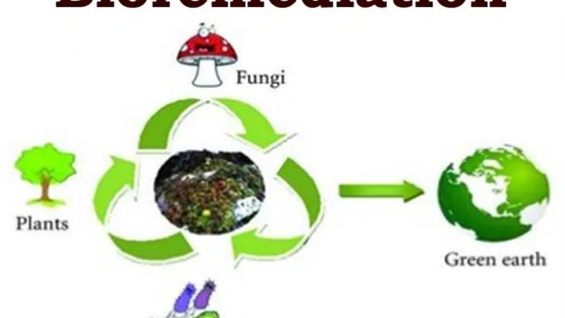
Bioremediation
Bioremediation is the
process of using biological organisms to break down hazardous substances into less toxic or nontoxic substances.

Slide 10
Bioremediation
According to Cornell University, “Bioremediation provides a technique for cleaning up pollution by enhancing the same biodegradation processes that occur in nature.” Although bioremediation happens naturally over time, scientists have developed ways to speed up the process through bioremediation technology.

Slide 11
3 ways of Bioremediation
The cleanup of contaminated soil
Oil spill cleanup
Crime scene clean up
Despite being red, Mars is a cold place
Mars
Mercury is the closest planet to the Sun
Mercury

Slide 12
01
Crime Scene Cleanup
Bioremediation in this sense involves the cleanup of blood and bodily fluids that can pose health risks such as hepatitis, HIV, and MRSA. Rather than using standard cleaning agents like bleach or ammonia, crime scene cleaners use enzyme cleaners to rid the scene of harmful substances.

Slide 13
The Cleanup of contaminated soil
Human activity has introduced many toxic substances into the environment’s soil and groundwater. During bioremediation, microbes utilize chemical contaminants in the soil as an energy source and, through
oxidation-reduction reactions, metabolize the target contaminant into useable energy for microbes.

Slide 14
01
Oil Spill Cleanup
There are instances in our country that oil spill happens like in the Guimaras oil spill occurred in the Panay Gulf on August 11, 2006, when the oil tanker MT Solar 1 sank off the coast of Guimaras and Negros islands in the Philippines, causing what is considered as the worst oil spill in the country.

Slide 15
Oil Spill Cleanup
These are:
Due to the effectiveness and lower cost of bioremediation, two methods were used to clean up an oil spill.
Bioaugmentation
Biostimulation

Slide 16
Bioaugmentation
which is the injection of a small number of oil-degrading
microbes into an affected area.

Slide 17
Biostimulation
which is the addition of nutrients to stimulate the growth of
innate oil-degrading microbes to increase the rate of remediation.

Slide 18
In-situ and Ex-situ tell us something about where the bioremediation is taking place. In-situ really just means in place or on-site (keeping something in its natural place), and ex-situ just means out of place or off-site (removing something from its natural place).

Slide 19
In-situ bioremediation means that you allow bioremediation to take place while leaving the soil or water in its natural location.The steps of in-situ bioremediation are site investigation, treatability studies, recovery of free product and removal of the contamination source, design and implementation of the in-situ bioremediation system, and lastly monitoring and performance evaluation of the in situ bioremediation system

Slide 20
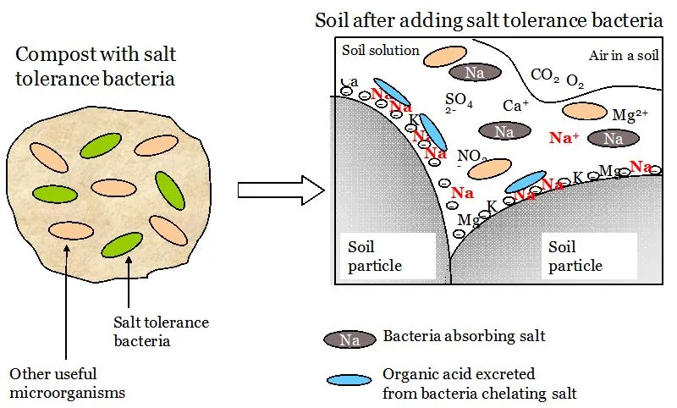
Ex-situ bioremediation means you would scoop up the contaminated soil or pump up the contaminated water and take it somewhere else for bioremediation (Hartsock, 2016).

